Slide 1
Automatic, Experiment-based
Diagnostics of Performance Problems
Alexander Wert
Software Design and Quality Group
Karlsruhe Institute of Technology

Slide 2






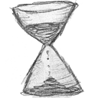




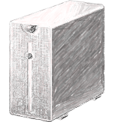



HELP!

Slide 3













Slide 4
to be continued …
.. in the poster & demo session!

