Slide 1
Generic Instrumentation and Monitoring Description for Software Performance Evaluation
Alexander Wert , Henning Schulz, Christoph Heger, Roozbeh Farahbod
February 3, 2015 – ICPE 2015 – Austin

Slide 2
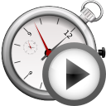


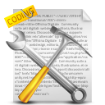




Motivation
Performance
Problems?
Performance
Model?
conceptually generic
Performance Tests &
Analysis Strategies
…
SUT specific
IaM Tool specific
Instrumentation and
Monitoring Description
Performance
Expert
Another IaM Tool
Instrumentation & Monitoring Tool
Measurement Environment
Another SUT
System under Test

Slide 3
Idea
Instrumentation & Monitoring Description Model (IDM)
→ Independent from specific:
  instrumentation and monitoring (IaM) tools
  system under tests
  programming languages
  (within the domain of modern-day, managed languages, e.g. Java, .NET, etc.)
<<meta-model>>
IDM
interprets
Instrumentation Engines
processes
instance of
instruments
<<model>>
IDM Instance
references
System under Test
references
contains
implementations
of
Generic Concepts

Slide 4
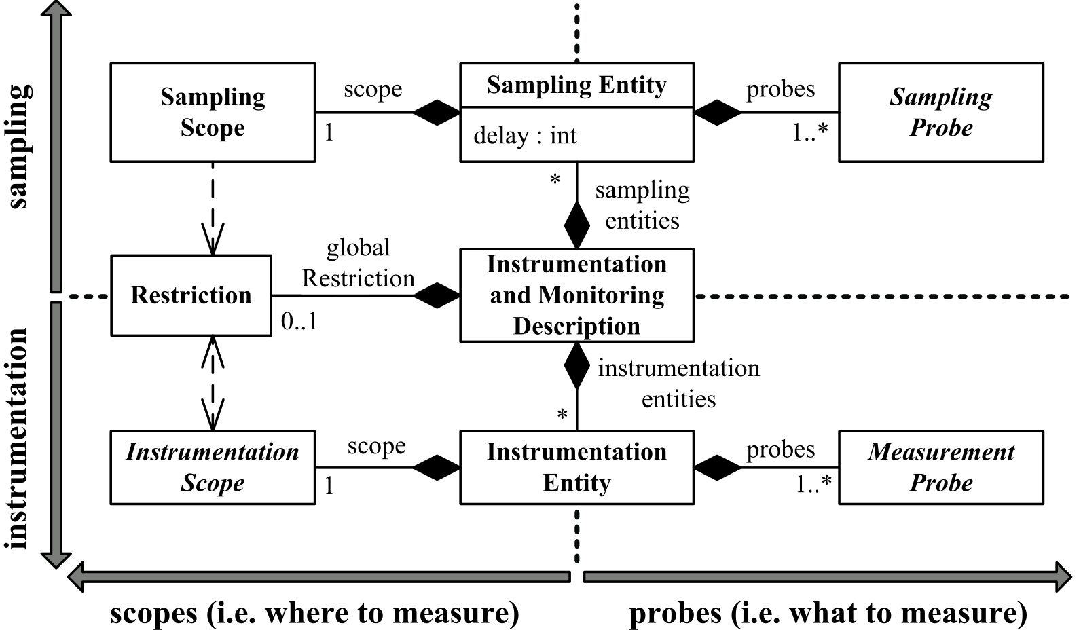
Design of IDM
CPU Utilization
Network Utilization
Memory Usage
Focus on Performance
Response Time
Composability
Memory Footprint
CPU Time
Abstraction
…
Orthogonality

Slide 5
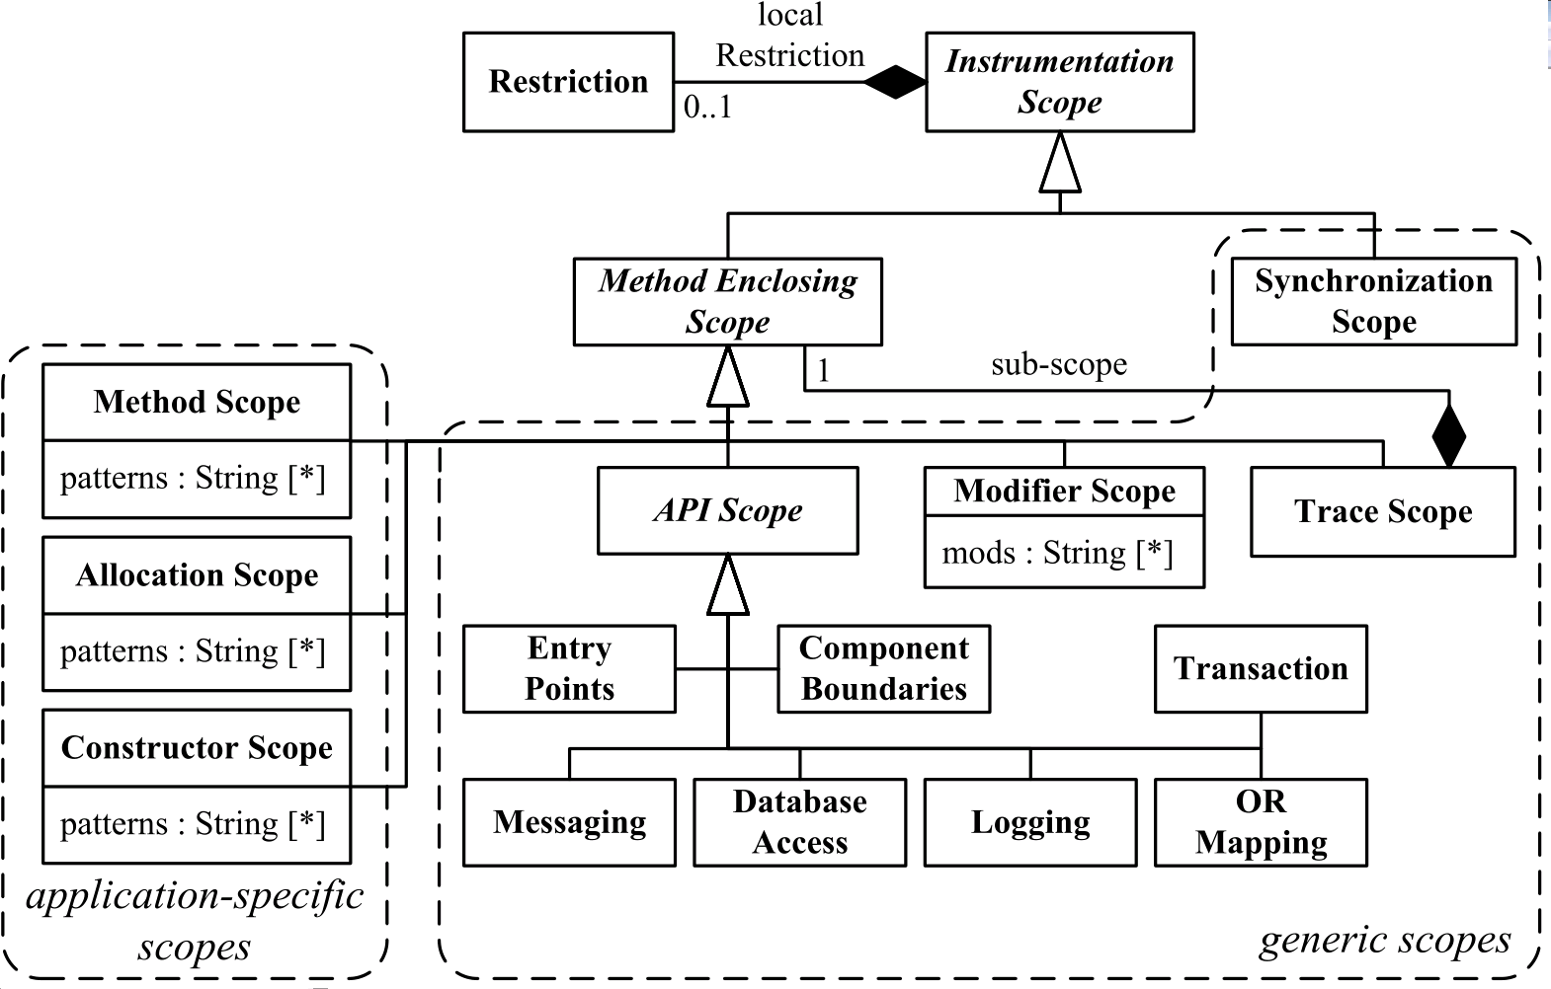
Instrumentation Scopes
exclude
*
include
*

Slide 6



Conclusion
context independent
Instrumentation Description Model
light-weight
composable
So far used in:
Automatic Performance Problem
Diagnostics
Adaptable Instrumentation
and Monitoring
Future Work:
More
probes and scopes
integrate with
extensibility
concept

Slide 7
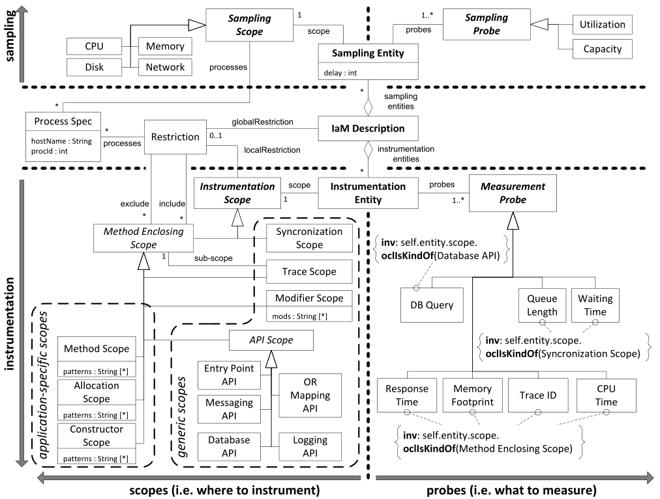
Backup

Slide 8
Related Work
Aspect Oriented Instrumentation Languages
  AspectJ [Kiczales et al., 1997]
  DiSL [Marek et al., 2012]
  Josh [Chiba et al., 2004]
  SCoPE [Aotani et al., 2007]
  language specific
  no focus on performance
Kieker [van Hoorn et al., 2012]
  uses AspectJ
  provides measurement probes for performance evaluation
  → measurement tool specific

