Slide 1
System Level Characterization of Datacenter Applications Manu Awasthi, Tameesh Suri, Zvika Guz, Anahita Shayesteh, Mrinmoy Ghosh, Vijay Balakrishnan Memory Solutions Lab, Samsung Semiconductor Inc.

Slide 2
Key Takeaways
Benchmarking datacenter platforms for scale-out applications is tough
Numerous moving parts involved : software and hardware
OS Kernel version, application version, system software stacks
Hardware – It’s not just the CPU!
CPUs – Number of sockets? Cores per socket? SMT Cores?
Memory Hierarchy
Amount and type of DRAM
Capacity and types of storage devices : SAS/SATA/PCIe/NVMe?
“Datacenter Benchmark” is a misnomer!
Applications need to be finely tuned for maximum utilization; there is no magic key
Increase in the number of components causes variability in results
Micro-architectural characterization doesn’t portray the entire picture; might be overkill
Macro architectural characterization!

Slide 3
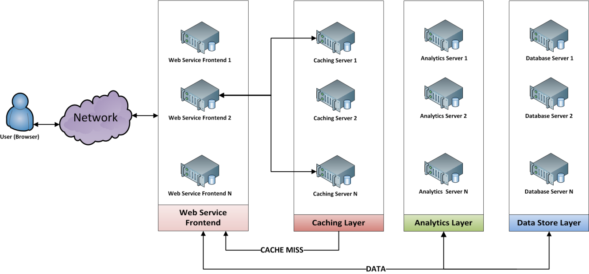
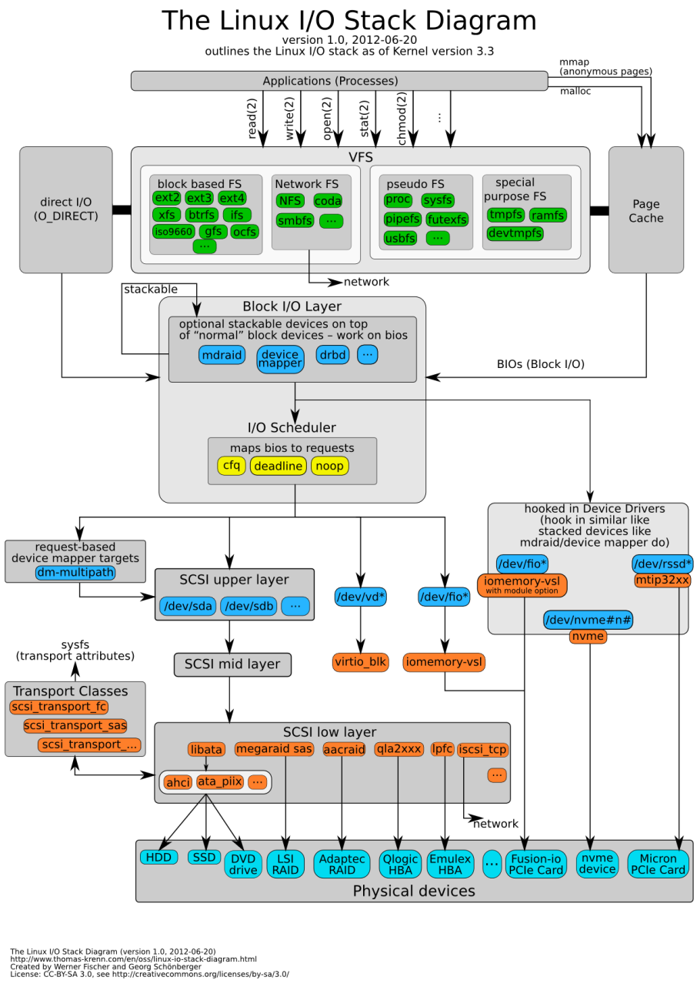
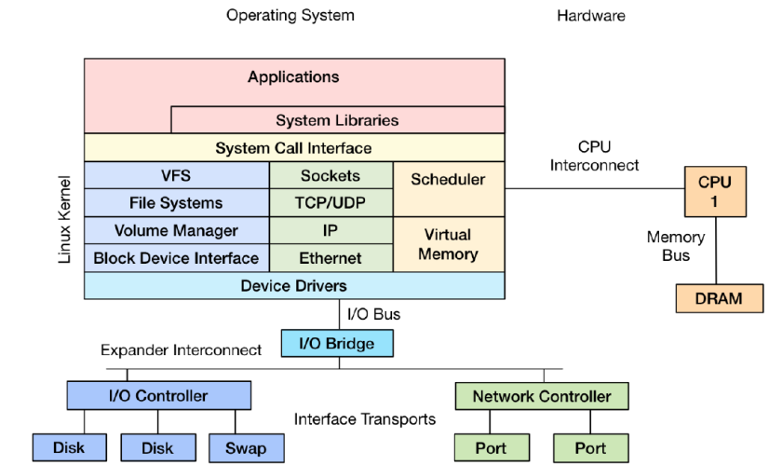
Motivation
Datacenter types : Enterprise, Cloud, Web 2.0
Each datacenter has multiple tiers of servers
Workloads are typically Client-Server
Exercise different hardware components and layers of the software stack depending on application
How to choose the best hardware/software configuration for each tier?
Img src: http://www.brendangregg.com/Slides/LinuxConEU2014_LinuxPerfTools.pdf

Slide 4
A Typical Request
REQ
RSP
But, how is the response generated at each server?

Slide 5

The Server System Software Stack
REQ Processing
RSP Formulation
RSP Dispatch
REQ Arrival
Image source: http://www.brendangregg.com/Slides/LinuxConEU2014_LinuxPerfTools.pdf

Slide 6
Benchmarking the Server Platform
Doesn’t involve just benchmarking the hardware
Also need to stress the right layers of the software stack
Make sure that the component being stressed the most is adequately provisioned
Make sure that requests are not spending most of their time in one component – hardware or software!
Application requirements change - each use case is different!
So, how do we go about doing it?
The goal should be “Provision every server to provide maximal utilization for each component, without excessive overprovisioning”
What are the available benchmarks?

Slide 7
Big-Data Benchmarks
Existing suites : CloudSuite, BigDataBench
Great collection of diverse workloads; smaller working set sizes
Actual working sets are much larger, more varied
Server side applications need to be better tuned
More on this later
Different applications exercise different components
DRAM, CPU, I/O
Some exercise all, others exercise a subset of the above
“Big Data”/Datacenter benchmarking is about benchmarking the entire server platform, not just specific components
The client side performance should play a role as well
A lot of prior work is focused on two extremes – client or server microarchitecture

Slide 8
State of the Characterization Spectrum
Per-Server Characteristics
Platform Characterization Spectrum
Client Side Results
(Industry Benchmarking)
Server CPU/µarch
(Academic Research)
CPU µarch : L1, L2, L3 I/D Cache, TLB Statistics, IPC/pipeline stalls, Branch prediction rate
DRAM: DRAM accesses, B/W, Page hits/misses
Transactions/Second
Client Scalability
Needed : “Middle of the spectrum” characterization
Need to know what’s going on with each component of the server
Not just the CPU, DRAM or Storage in isolation
Each component can have an intensity
Intensity can be comprised of multiple, smaller sub-components

Slide 9

Macro Architectural Intensity
Intensities to consider depends on server tier and application
Intensity – marking a region of the ecosystem where an application spends a lot of time
Comprises of number of smaller components
CPU
IPC
Cache Misses
I/D TLB Hit Ratio
MPKI
Storage Devices
IOPS
B/W
Latency
DRAM
Hits/Misses
Channel B/W Utilization
Bank Parallelism
Latency
Network
Reads vs. Writes
B/W Utilization

Slide 10
Benchmarks and Test Setup
Data Caching : Memcached
Client - Memcslap
Data Store: Cassandra
Client - YCSB
Real Time Analytics – REDIS
Offline Analytics : Hadoop MapReduce
Data Analytics
Web Indexing – Nutch
Resource | Value
Processor | Xeon E5-2690, 2.9GHz, dual socket-8 cores
Storage | 3× SATA 7200RPM HDDs
Memory Capacity | 128 GB ECC DDR3 R-DIMMs
Memory B/W | 102.4 GB/s (8 channels,DDR3-1600)
Network | 10 Gigabit Ethernet NIC
Operating system | Ubuntu 12.04.5

Slide 11
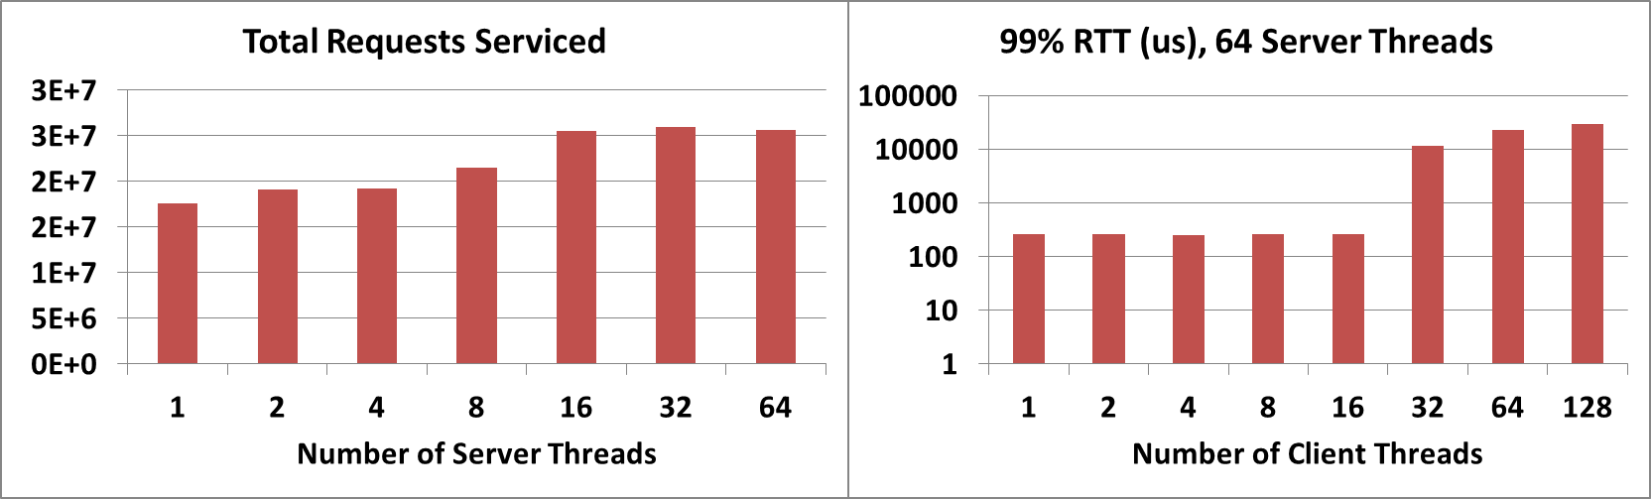
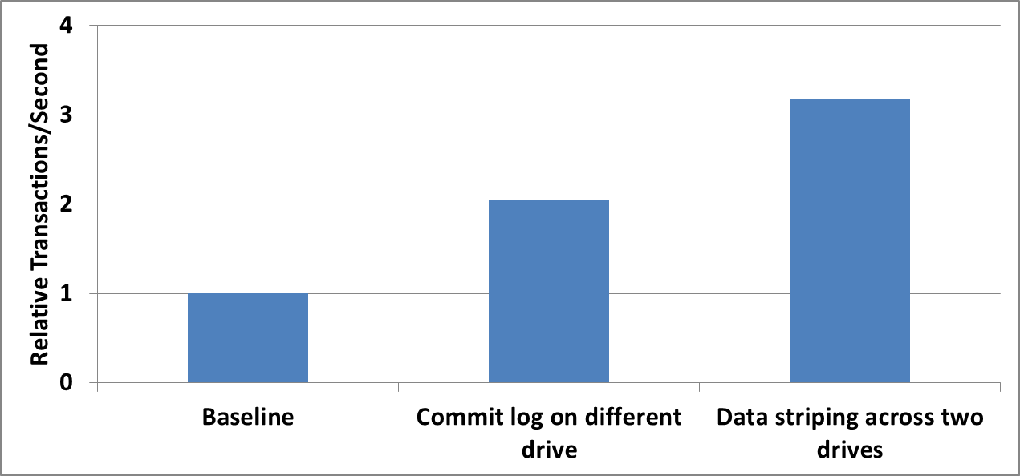
Importance of Fine Tuning Workloads
Memcache Client and Server Thread Scaling
SCAN Intensive Workload – Cassandra + YCSB

Slide 12
Importance of Fine Tuning Workloads - II
< 600 MB/Map results in errors; > 800 MB/Map has no performance impact

Slide 13
“Macro-Architectural” Characterization
Need to find some parameters that provides relevant information about the state of each server
Extremely useful for scaling studies : is a subset of servers behaving differently under load?
What are the axes that we should consider? For datacenters, the usual suspects:
CPU Intensity
Memory Intensity
Storage and I/O : Disk Intensity
Network Intensity
Each characteristic has multiple components that decides its intensity
One program can have multiple phases with different intensities for different characteristics
Identifying the right types of intensities for each phase of the workload for each phase – near optimal resource utilization sans overprovisioning

Slide 14
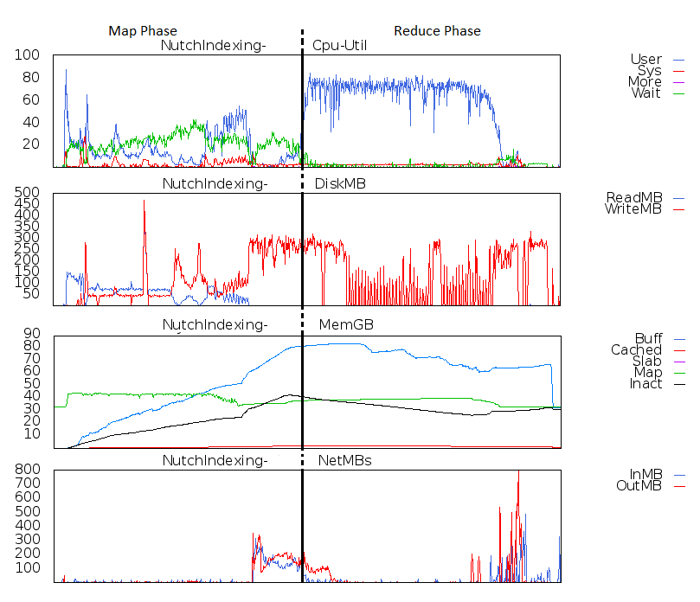
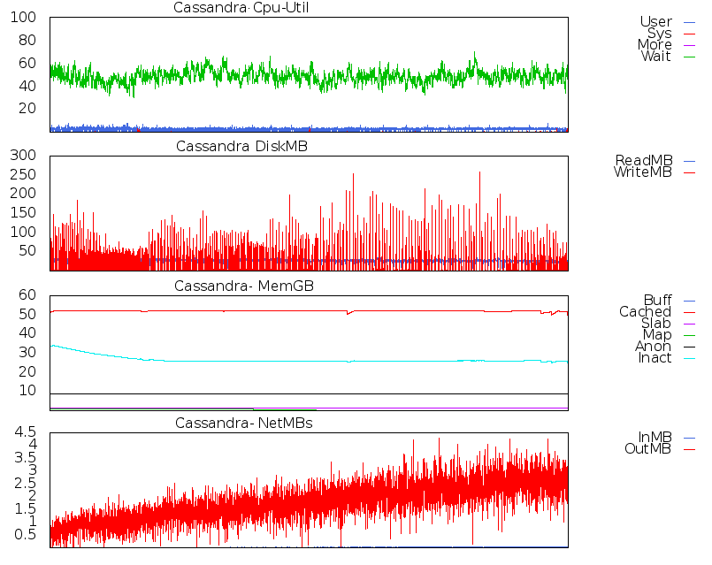
Comparison of Macro Architectural Characteristics
CPU waiting
CPU executing
Lot of Disk writes
Network Util Peaks
Nutch
Cassandra
Identify workload requirements by observing macro-arch profiles!

Slide 15
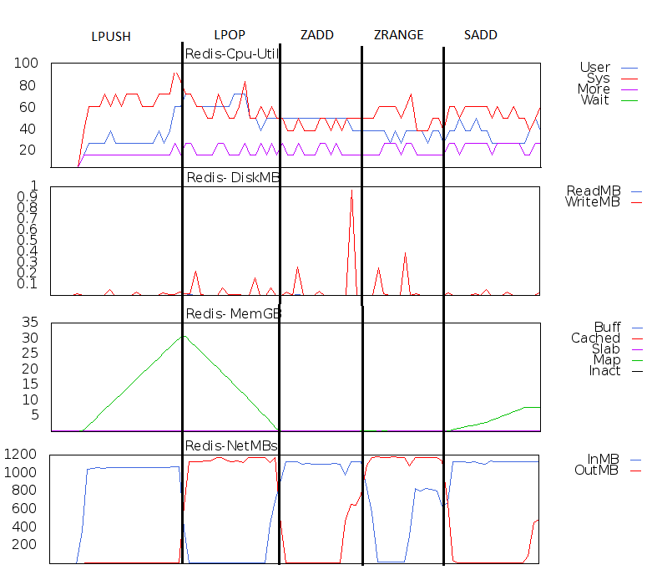
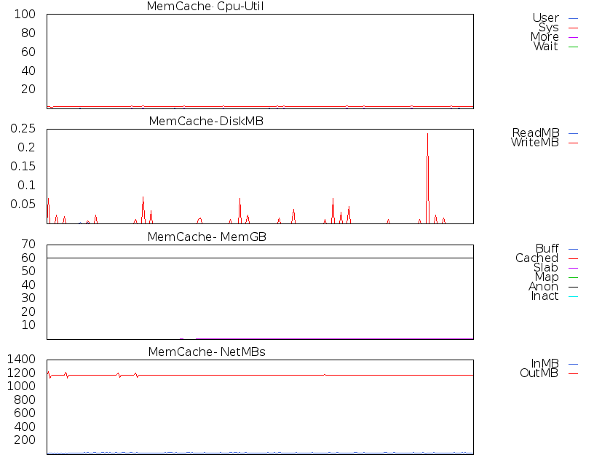
Comparison of Macro Architectural Characteristics
Extremely Network Intensive
Very little DRAM B/W Utilization
REDIS
Memcached

Slide 16
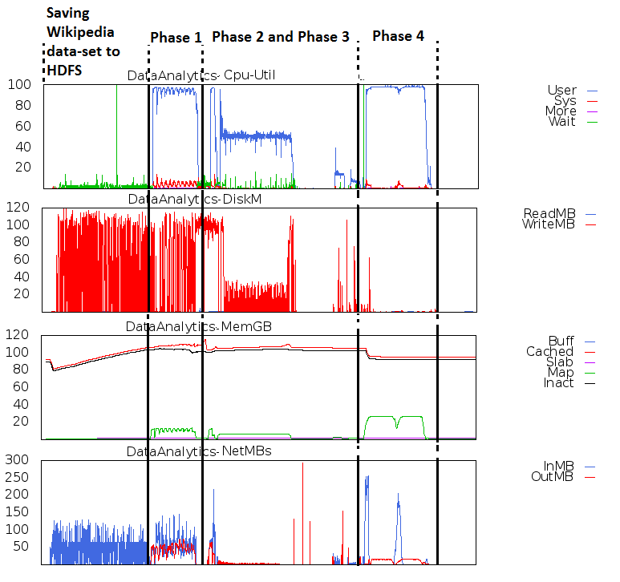
Change of Phases – Data Analytics

Slide 17
How are Macro Characteristics Helpful?
Design the system based on characteristics – adequately provision the components that will be stressed
Each tier should be provisioned based on identified intensities
Amount of provisioning will be determined based on use case
Workload | Pressure Points
Memcache | DRAM, Network
Cassandra | Disk
Redis | Network
Nutch (Hadoop) | CPU, Disk
Data Analytics (Hadoop) | CPU

Slide 18
Key Takeaways
Benchmarking datacenter platforms for scale-out applications is tough
Numerous moving parts involved : software and hardware
OS Kernel version, application version, system software stacks
Hardware – It’s not just the CPU!
CPUs – Number of sockets? Cores per socket? SMT Cores?
Memory Hierarchy
Amount and type of DRAM
Capacity and types of storage devices : SAS/SATA/PCIe/NVMe?
“Datacenter Benchmark” is a misnomer!
Applications need to be finely tuned for maximum utilization; there is no magic key
Increase in the number of components causes variability in results
Micro-architectural characterization doesn’t portray the entire picture; might be overkill
Macro architectural characterization!

Slide 19
Thanks!
Questions?

Slide 20
Backup Slides

